Slide 1
Unit testing - Best practices

Slide 2

Introduction
Sergey Kichuk
skichuk@luxoft.com
Skype: exiton3
http://luxoft-training.ru
http://luxoft-training.com

Slide 3
What are the qualities of good unit test?
Make the tests Trustworthy
Create Maintainable tests
Readable tests

Slide 4
Readable tests

Slide 5
Readable tests
It is important that tests should be readable and
have name standards because they provide documentation for the code not only check that your code work.

Slide 6
Readable tests
Tests structure
Naming convention
No magic values
Separate assert from action
AAA - Arrange, Act, Assert pattern

Slide 7
Naming conventions
The name of test should answer on 3 questions
What do we test?
What is the scenario or input state?
What is expected result or behavior?

Slide 8
Naming conventions
The name of your test should consist of 3 parts:
The name of the method being tested.
The scenario under test or input state
The expected behavior when the scenario is invoked.

Slide 9
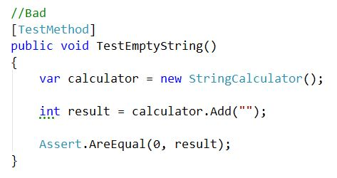
Naming conventions :

Slide 10
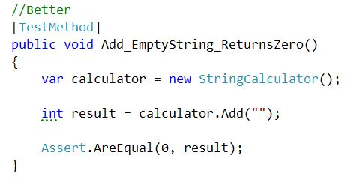
Naming conventions :

Slide 11
AAA - pattern:
Arrange, Act, Assert is a common pattern when unit testing. As the name implies, it consists of three main actions:
Arrange your objects, creating and setting them up as necessary.
Act on an object.
Assert that something is as expected.

Slide 12
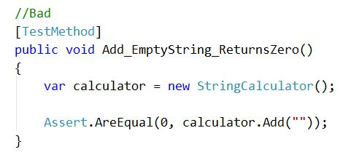
AAA - pattern:

Slide 13
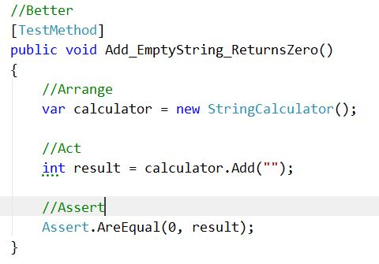
AAA - pattern:

Slide 14
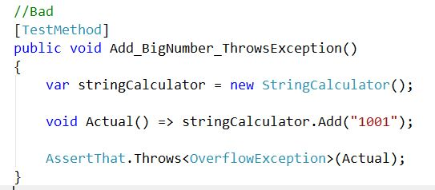
Magic values:

Slide 15
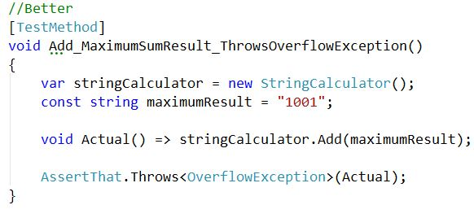
Magic values:

Slide 16
Tests Structure
One Test assembly per Code assembly.
Name of Test class should be same as tested class with postfix ‘Tests’

Slide 17
Trustworthy tests

Slide 18
Trustworthy tests
Test the right thing
Make it easy to run
Separation of Unit and Integration tests
Avoid manual Mock logic
Don’t repeat production logic
Write in TDD manner

Slide 19
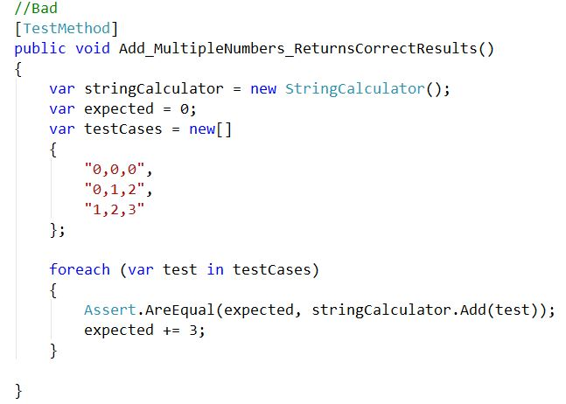
Avoid Logic in Tests :

Slide 20
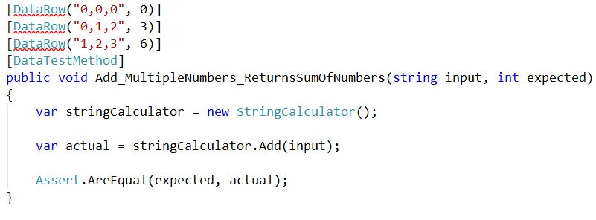
Avoid Logic in Tests :

Slide 21
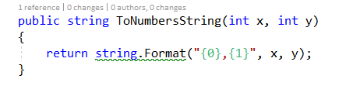
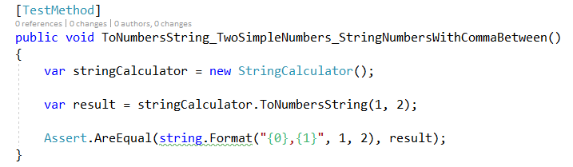
Production Logic in Tests :

Slide 22
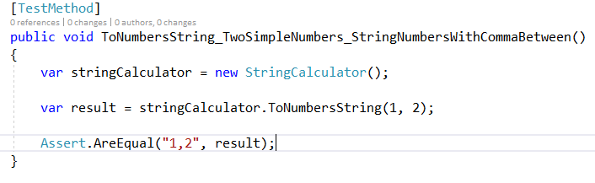
Production Logic in Tests :

Slide 23
Maintainable tests

Slide 24
Maintainable tests
Test one thing
No multiple asserts (except if have to assert properties for on object)
One Mock per test
Re-use of test code (Create, Make, Init etc)(Demo)
Enforce test isolation (no dependency between tests)

Slide 25
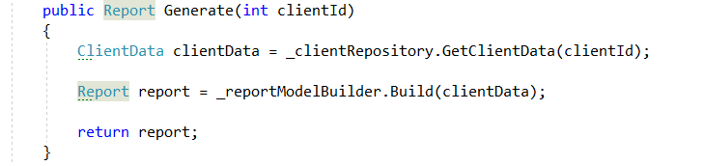
Maintainable tests: Sample code

Slide 26
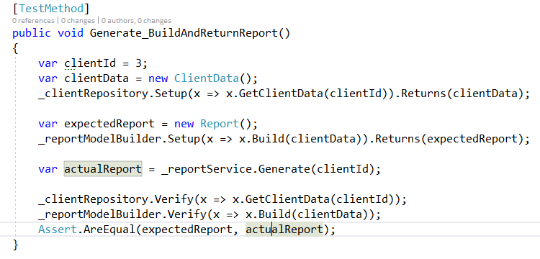
Maintainable Tests

Slide 27
One Mock per test
Mock is not Stub
Mock – is fake object for verify expected behavior of tested class
Stub – is fake object just for help to compile and run the test
Both are Fake

Slide 28
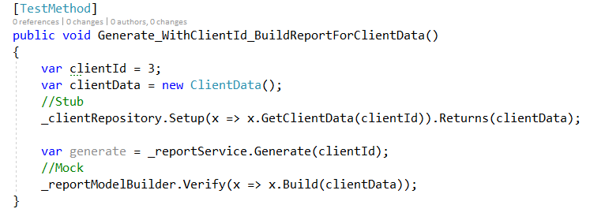
One Mock per test

Slide 29
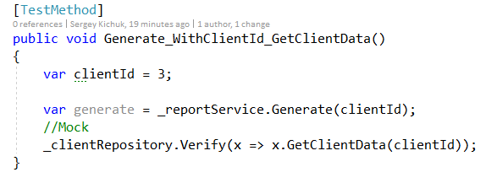
One Assert

Slide 30
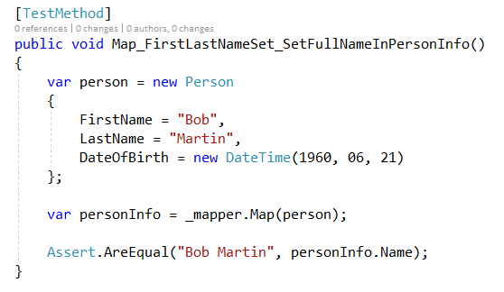
Reuse test code

Slide 31
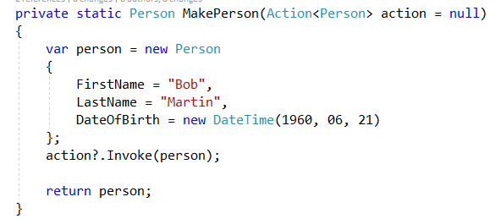
Reuse test code

Slide 32
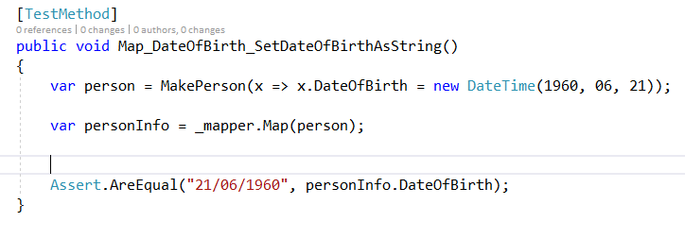
Reuse test code

Slide 33
references
The Art of Unit Testing: with examples in C# By Roy Osherove
Test Driven Development: By Example by Kent Beck
Top The Best books for Software Developer

Slide 34
Q&A

Slide 35
Color Gamma

